Slide 1



GRAPHS AND SOCIAL NETWORK PROJECT

Slide 2

TEAM MEMBERS
RAGHU 22BDS014
SATHVIK 22BDS020
RAJ 22BDS055
SUHAAS 22BDS056

Slide 3
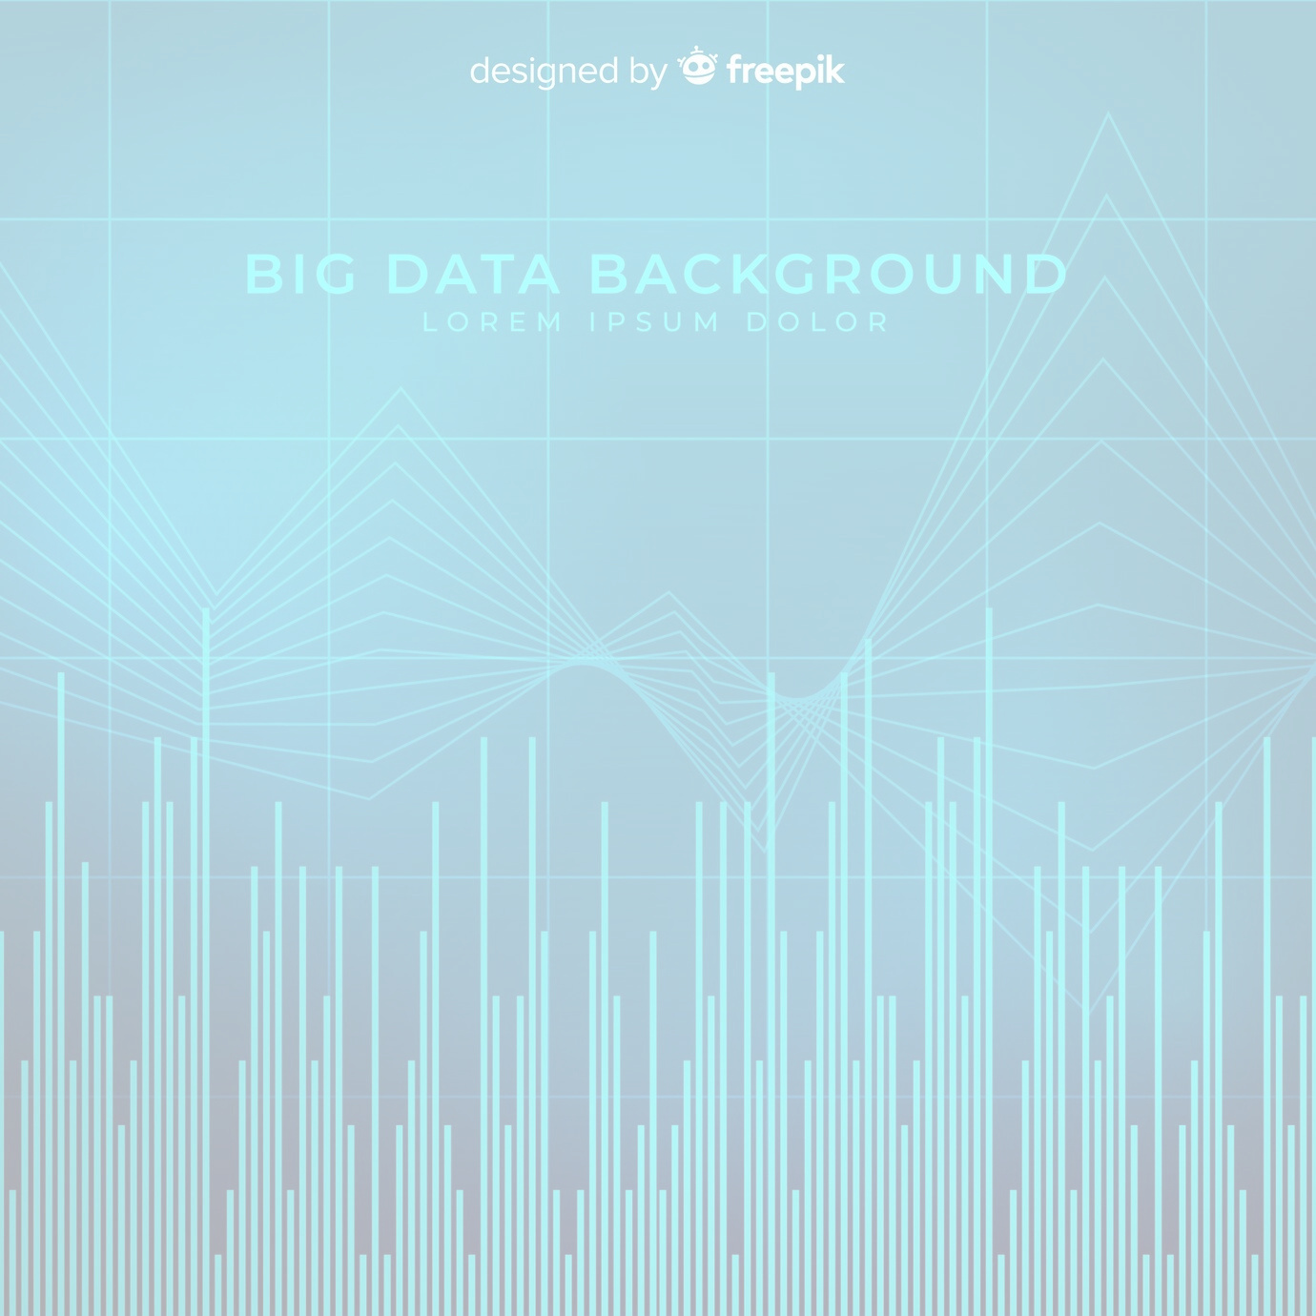
ABOUT THE DATASET
Dataset Description : The American College Football dataset
This dataset provides a graph-based representation of the network of football games between Division IA colleges in Fall 2000, capturing which universities played against each other
Graph Representation : The dataset is represented as an undirected graph where nodes correspond to teams and edges correspond to games. The teams are grouped by conference, and the dataset highlights the intra-conference and inter-conference games, making it useful for exploring community structures within the network.

Slide 4
ABOUT THE DATASET
Nodes : Each node in the dataset represents a college football team. The dataset includes teams from various conferences in the NCAA (National Collegiate Athletic Association) league.
Number of nodes : 115
Edges : Edges represent games played between two teams. An edge connects two nodes (teams) if they played against each other in that season.
Number of edges : 613

Slide 5
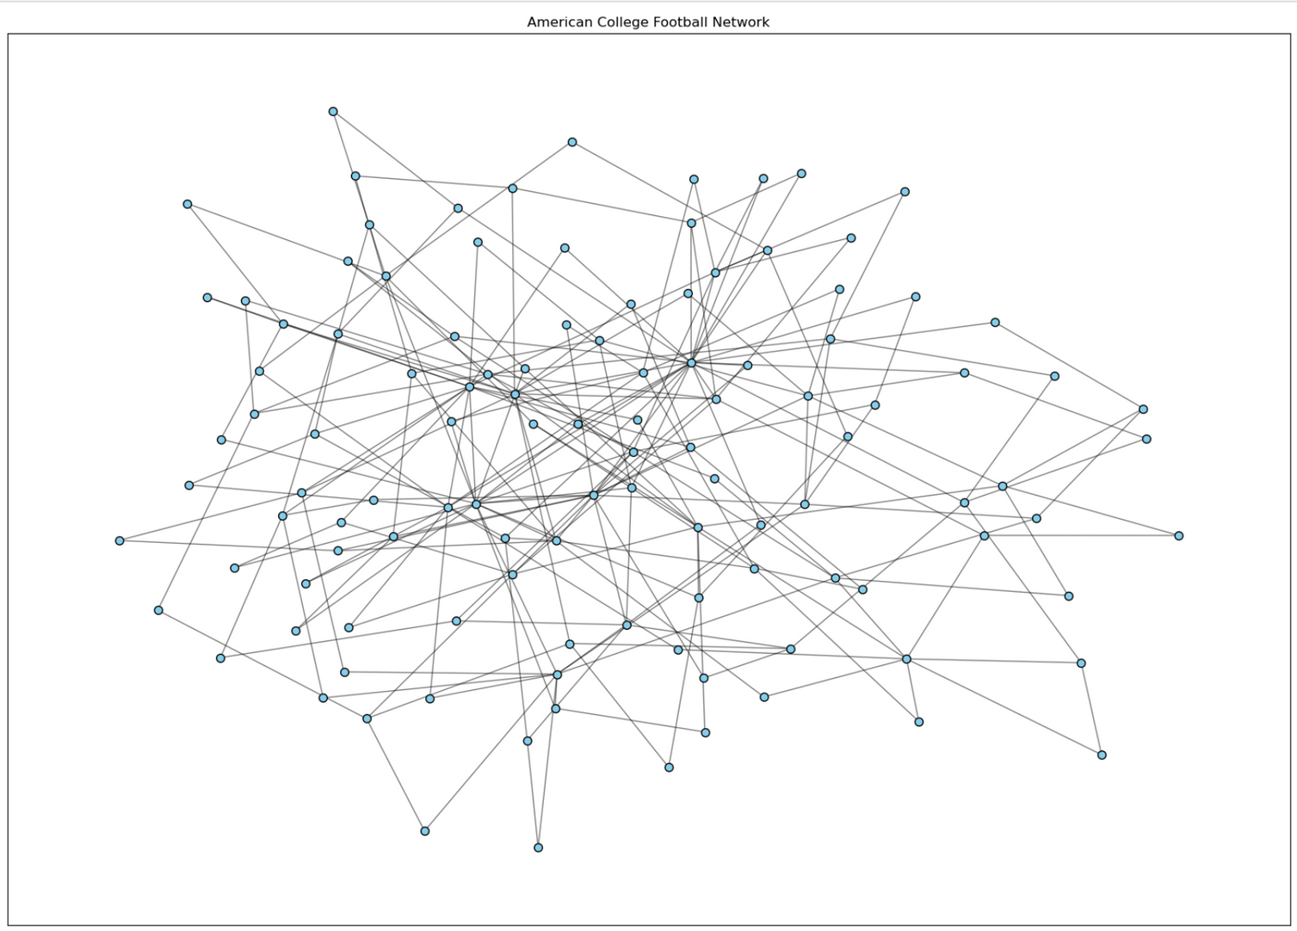
GRAPH REPRESENTATION

Slide 6
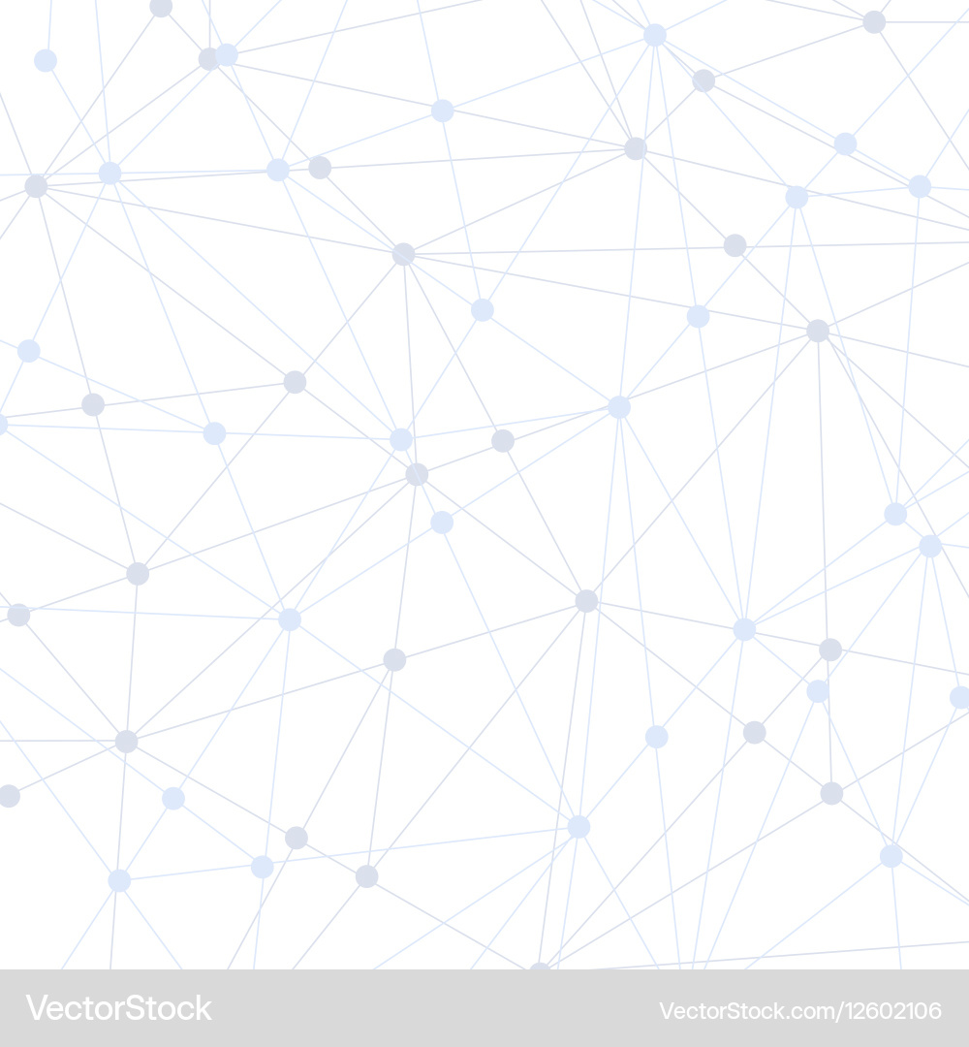
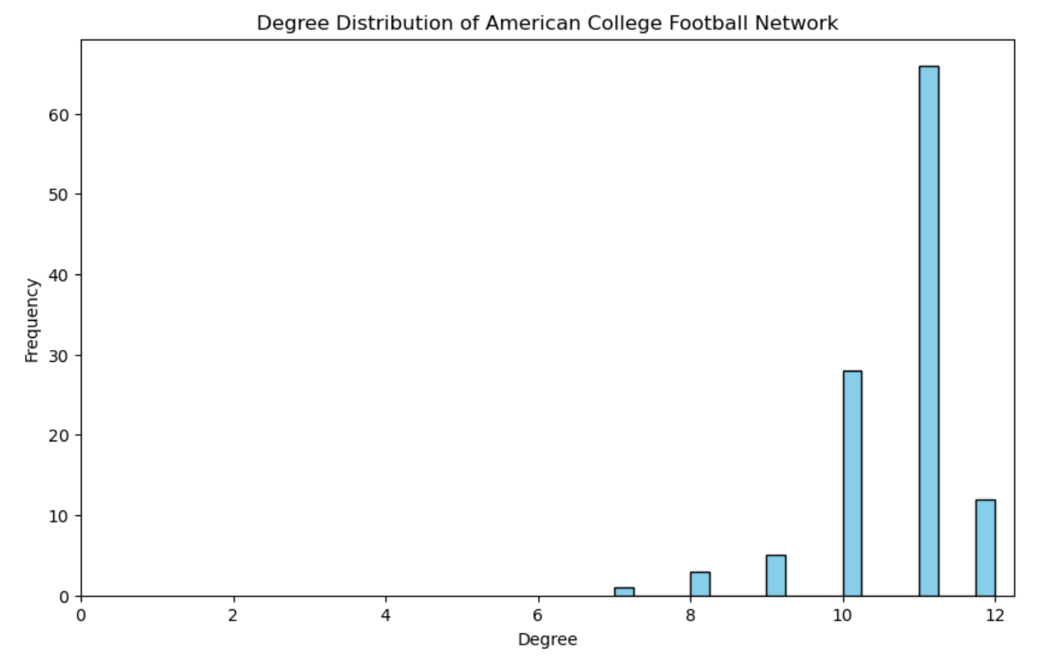
DEGREE DISTRIBUTION
The degree distribution shows how many games each team played, with most teams having a typical number of connections. A few teams stand out with higher degrees, acting as hubs within the network. This right-skewed distribution highlights the structure and key teams in the network.

Slide 7
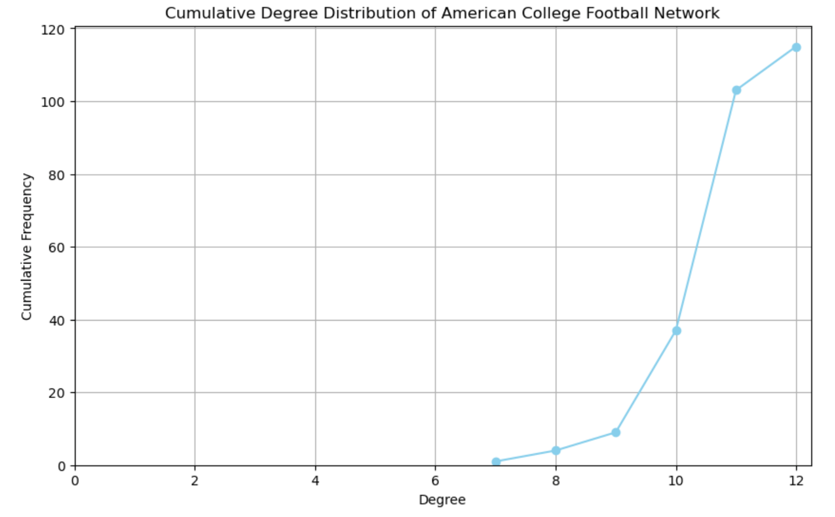
CUMuLATIVE DEGREE DISTRIBUTION
The cumulative degree distribution illustrates the proportion of teams with degrees up to a certain threshold. Most teams fall within a moderate degree range, while only a few have very high degrees. This trend highlights the presence of a few highly connected teams within the network.

Slide 8
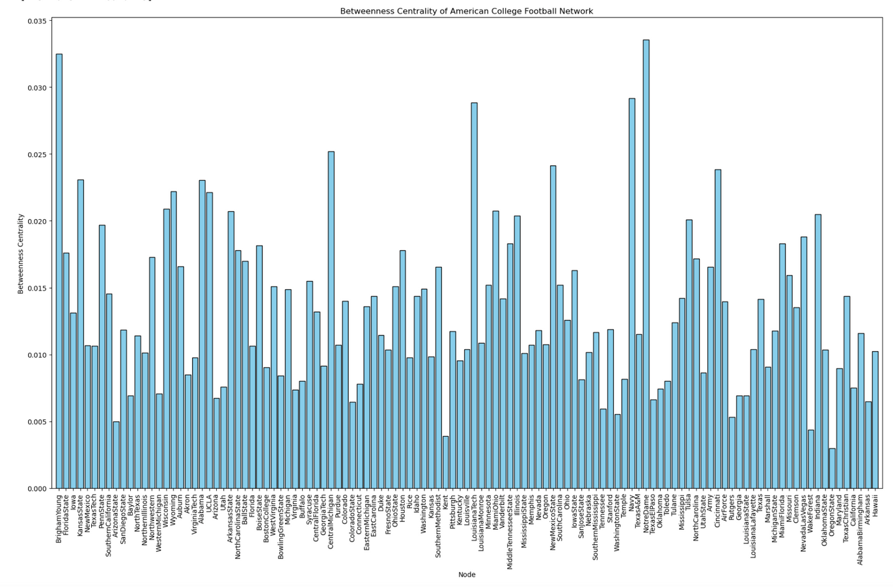
BETWEENNESS CENTRALITY
Betweenness centrality in our dataset identifies key teams that serve as critical links between different groups. Teams with high betweenness centrality are pivotal for network flow, connecting otherwise distant teams. This metric helps reveal influential teams in terms of game connectivity across the network.

Slide 9
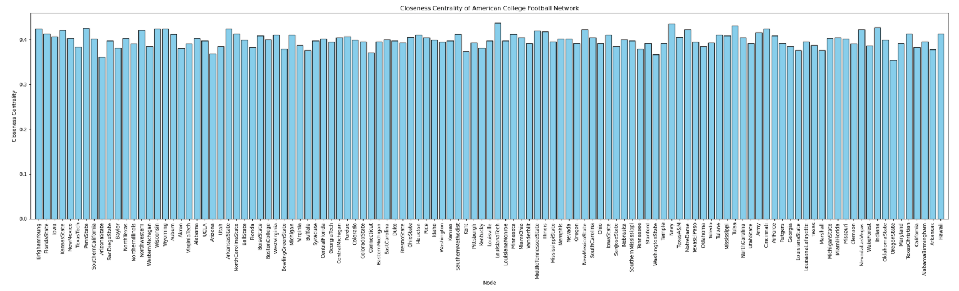
CLOSENESS CENTRALITY
Closeness centrality measures how quickly a team can reach all others through the network. Teams with high closeness centrality have shorter average paths to other teams, indicating strategic positions within the network. This metric highlights teams that can spread information or influence efficiently across the network.

Slide 10
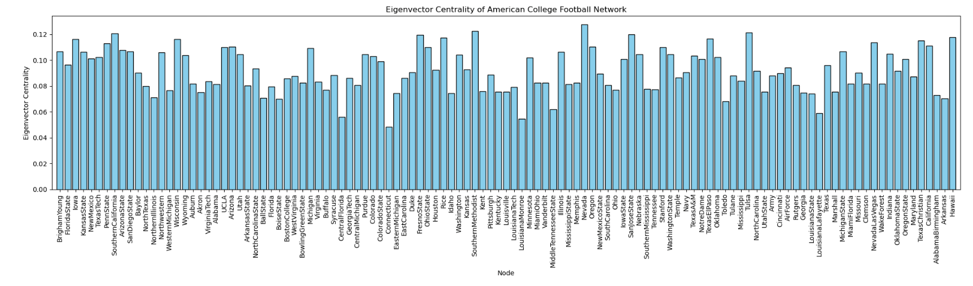
EIGEnvector CENTRALITY
Eigenvector centrality highlights teams connected to other well-connected teams, showing their influence within the network. High eigenvector scores indicate teams with strong connections to central hubs. This helps identify key teams in influential positions across the network.

Slide 11
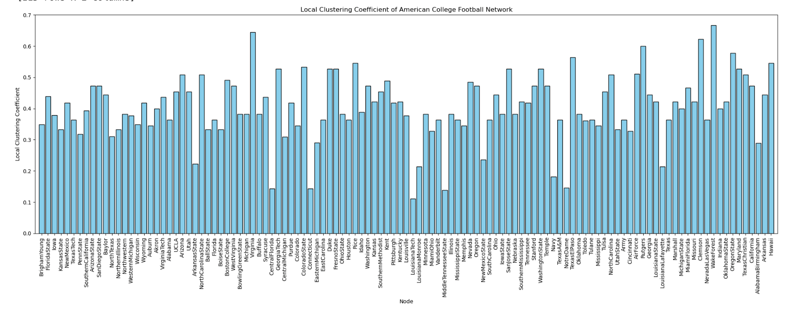
local clustering coefficient
Local clustering coefficients measure how interconnected a team's neighbors are within the network. High coefficients indicate teams whose connections form tightly-knit groups. This metric helps identify clusters or localized communities in the network.

Slide 12
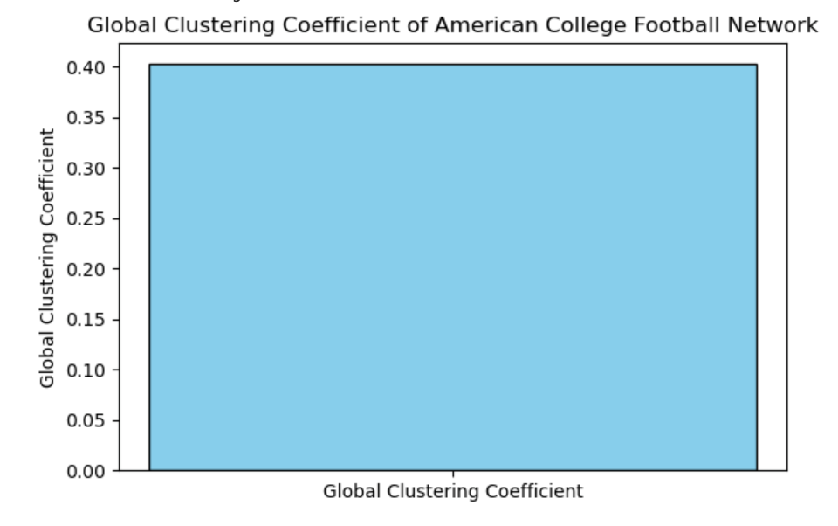
GLOBAL clustering coefficient
The global clustering coefficient measures the overall tendency of teams in the network to form triangles. A higher coefficient indicates a more interconnected network with teams forming dense clusters. It reflects the general cohesiveness of the entire football network.

Slide 13
connected components
Connected components represent isolated subgroups of teams within the network. Our dataset has a single large connected component, indicating most teams are linked. Identifying connected components helps reveal how teams are grouped and interact within the network.
Number of connected components : 1

Slide 14
Girvann Newmann algorithm
The Girvann Newmann algorithm detects communities by iteratively removing edges with the highest betweenness centrality. In our dataset, it identifies tightly-knit groups of teams that play more frequently against each other. The algorithm helps uncover conference-like structures within the football network. As edges are removed, the network splits into smaller components, revealing these communities. This method is useful for understanding the competitive and geographic groupings of teams.

Slide 15
breadth first search (Bfs)
BFS explores the network layer by layer, starting from a given node (e.g., a football team) and visiting all neighboring nodes first. It helps find the shortest path in an unweighted graph. In our dataset, BFS reveals how quickly a team can reach other teams. It also helps understand the network's spread and connectivity. BFS is useful for analyzing the reachability of teams within the network.

Slide 16
DEPth first search (dfs)
DFS explores the network by going as deep as possible along each branch before backtracking. It helps identify connected regions and potential isolated subgroups. In our dataset, DFS uncovers the underlying structure of the network by traversing through teams' connections. It is effective in detecting clusters or paths between teams. DFS is valuable for understanding the hierarchical structure within the network.

Slide 17
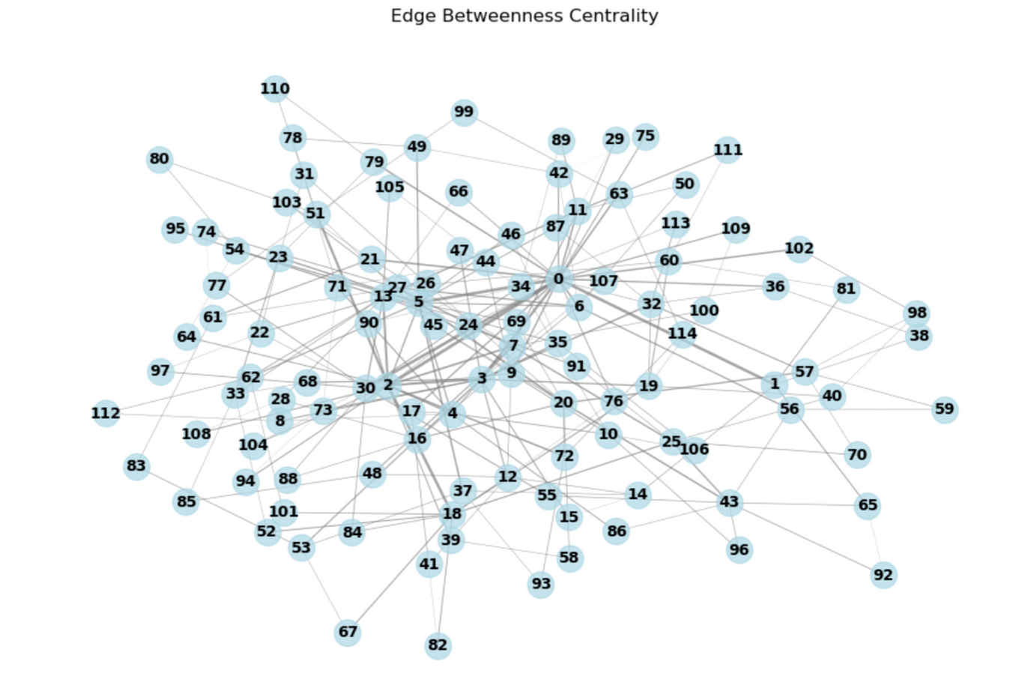
Edge betweenness centrality
Edge betweenness centrality measures the importance of edges in connecting different parts of the network. In our dataset, edges with high betweenness centrality act as bridges between tightly connected groups of teams. These edges are critical for the flow of information or competition between teams. High betweenness centrality edges can reveal key matchups or rivalries within the football network. Identifying such edges helps in understanding the network's structure and key connections.

Slide 18
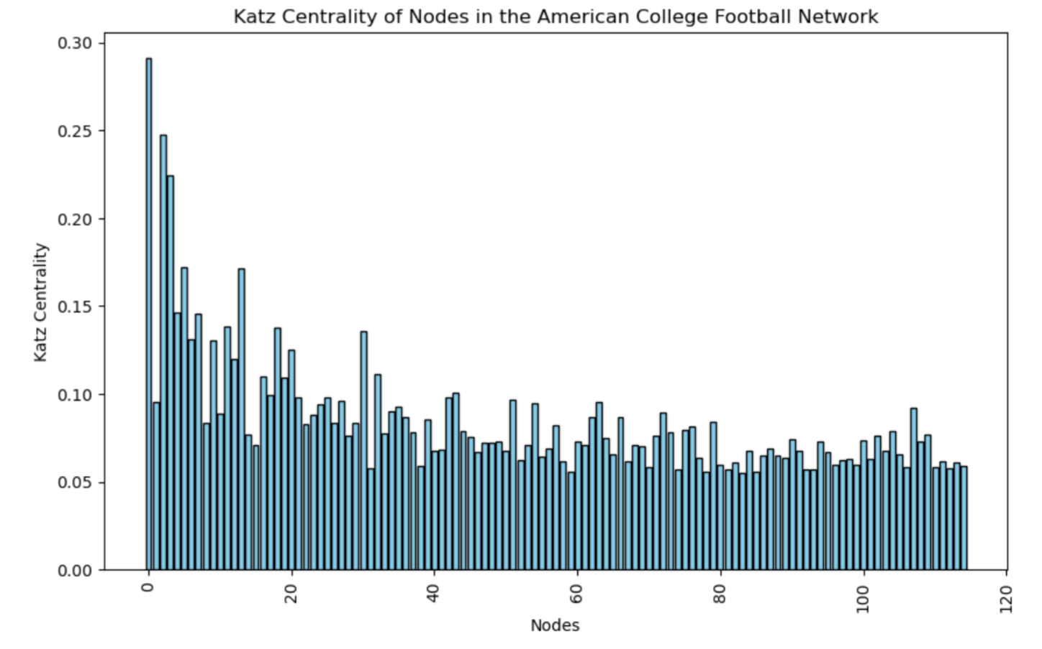
KARTZ centrality
Katz centrality measures the influence of a team based on both direct and indirect connections within the network. Teams with higher Katz centrality are more central, having strong ties with other influential teams. This metric helps identify key teams that play pivotal roles in connecting various parts of the football network.

Slide 19
core number
The core number of a node represents the largest k-core that the node belongs to in the network. A k-core is a subgraph where each node has at least k connections within the subgraph. Nodes with higher core numbers are more interconnected and play a central role in the network’s structure. In our dataset, core numbers help identify the most robust teams that are critical to the network's cohesion. These teams are likely to have a higher degree of connectivity and influence in the football network.
Core number for each node : 8

Slide 20
K-cliques
K-cliques in our dataset represent subgroups of teams that are fully connected to each other, where each team in the clique has direct connections with every other team. These cliques reveal tightly-knit groups of teams with strong interrelationships. A k-clique with a higher value of k indicates a more cohesive and influential group within the network. Identifying k-cliques helps us understand communities of teams that are highly collaborative or competitive. In our dataset, k-cliques highlight key clusters of teams that dominate the football network in terms of connectivity.
Total number of 3-cliques found: 64

Slide 21
K-clans
K-clans represent densely connected subgroups within the network, where each node in the subgroup is connected to at least k other nodes within the same group. This measure identifies tightly-knit clusters of teams that are highly interconnected. Teams within a k-clan have strong mutual interactions and significant local influence. In our dataset, k-clans highlight groups of teams that form close-knit, influential communities. The size and connectivity of these k-clans reveal important relationships in the football network’s structure.

Slide 22
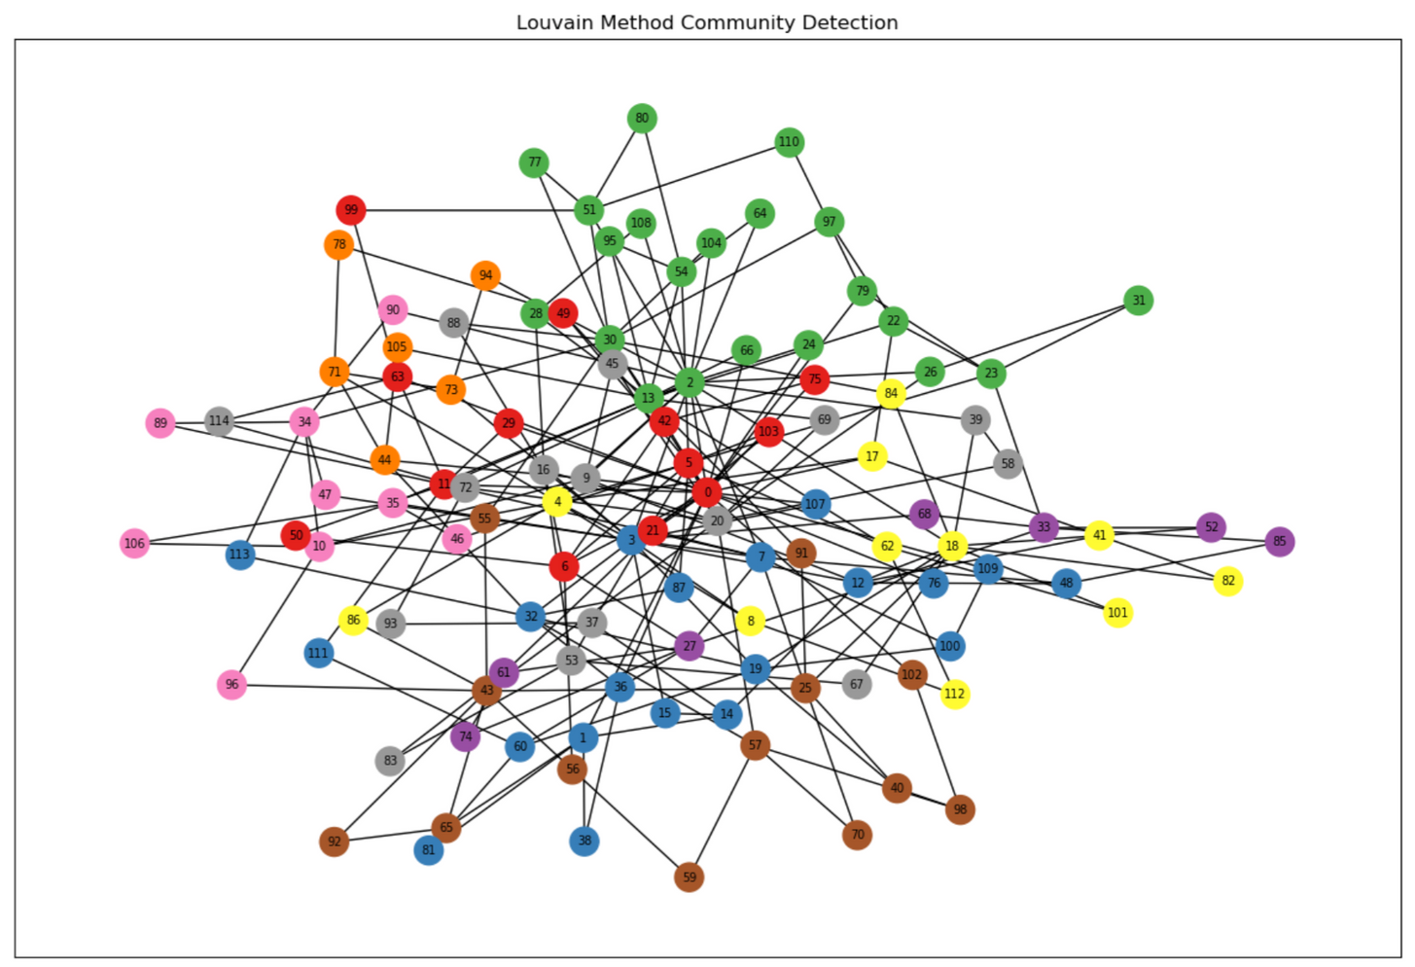
louvian method
The Louvain method is a community detection algorithm that identifies clusters of tightly connected teams in the network. It optimizes modularity, which measures the strength of divisions between communities. In our dataset, this method uncovers groups of teams that are more internally connected than with the rest of the network, revealing natural community structures.

Slide 23
Watts-Strogatz model
The Watts-Strogatz model is a small-world network model that combines high clustering with short path lengths. In our dataset, applying this model would help simulate a network where teams are highly interconnected locally but can also quickly reach distant teams. This model is useful for capturing the real-world dynamics of football networks, where some teams are very close to each other, while others are far but still connected. It emphasizes the balance between local clustering and global connectivity. The Watts-Strogatz model can reveal the resilience and navigability of the network structure.
Watt-Strogatz Graph Properties:
Average Clustering Coefficient: 0.3577
Average Path Length: 4.8711

Slide 24
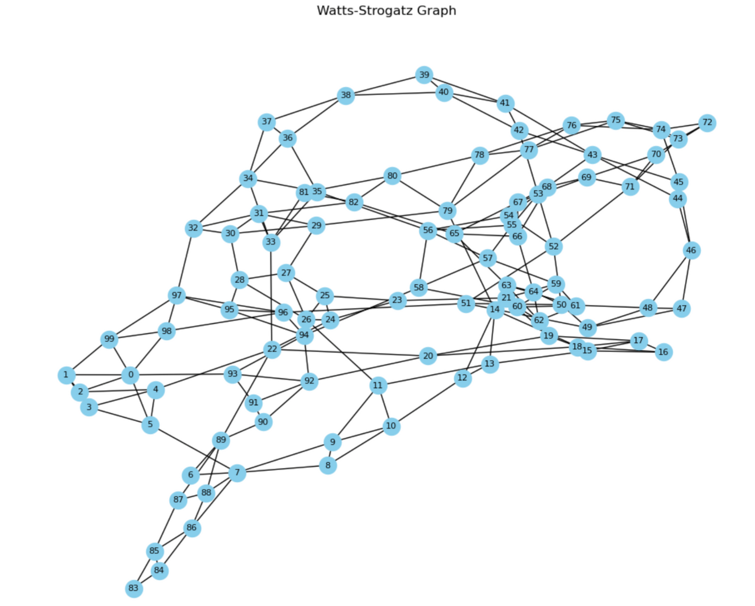
Watts-Strogatz model

Slide 25
Barabási-Albert model
The Barabási-Albert model generates scale-free networks, where nodes are more likely to connect to already well-connected nodes. In our dataset, this model helps simulate the preferential attachment phenomenon observed in the American College Football Network, where some teams have significantly more connections than others. This model highlights the presence of "hub" teams that dominate the network in terms of interactions. By applying this model, we can better understand how teams attract connections over time, leading to a power-law distribution of node degrees. This structure reflects the natural evolution of team interactions and how certain teams gain prominence in the network.
Barabási-Albert Graph Properties:
Average Clustering Coefficient: 0.1039
Average Path Length: 3.0093

Slide 26
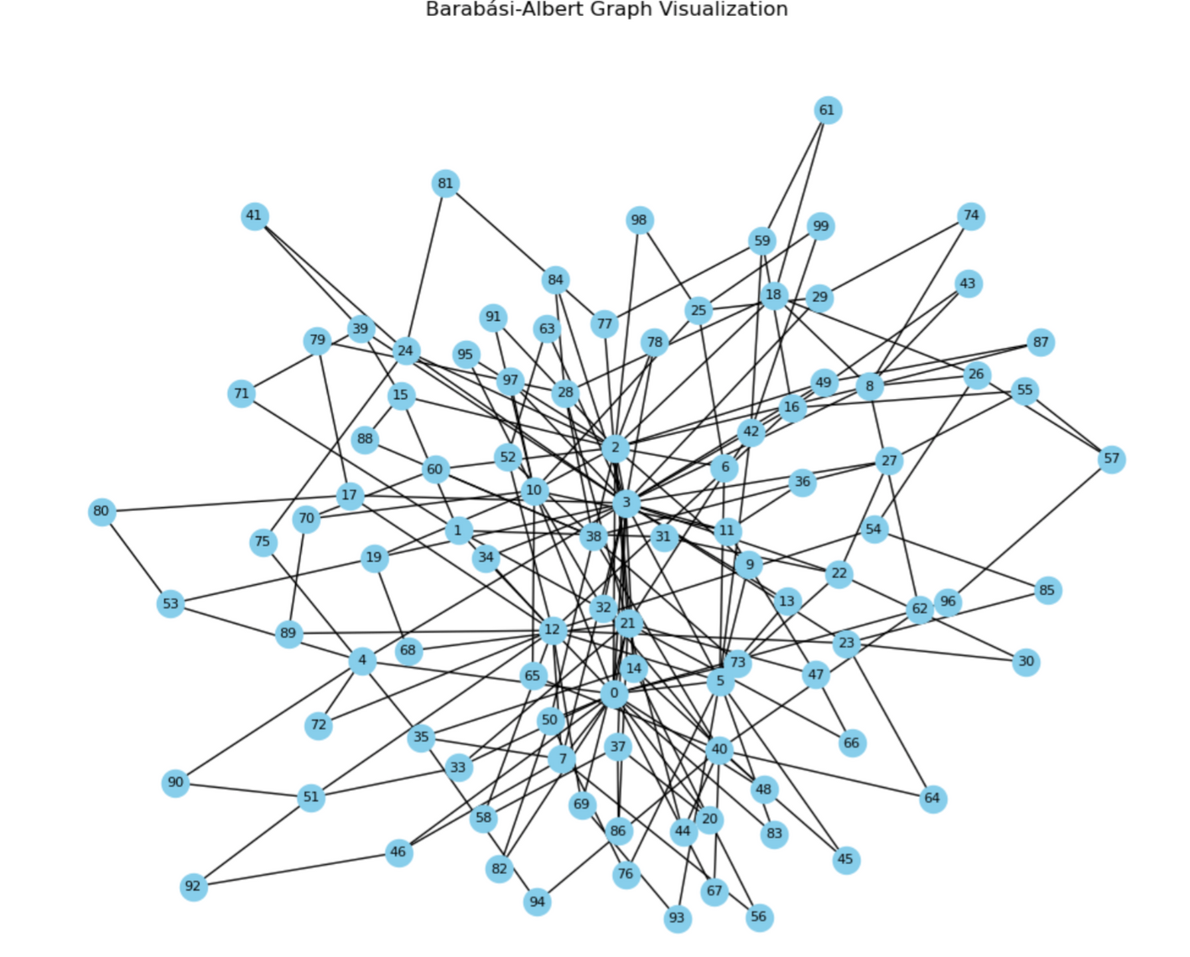
Barabási-Albert model

Slide 27
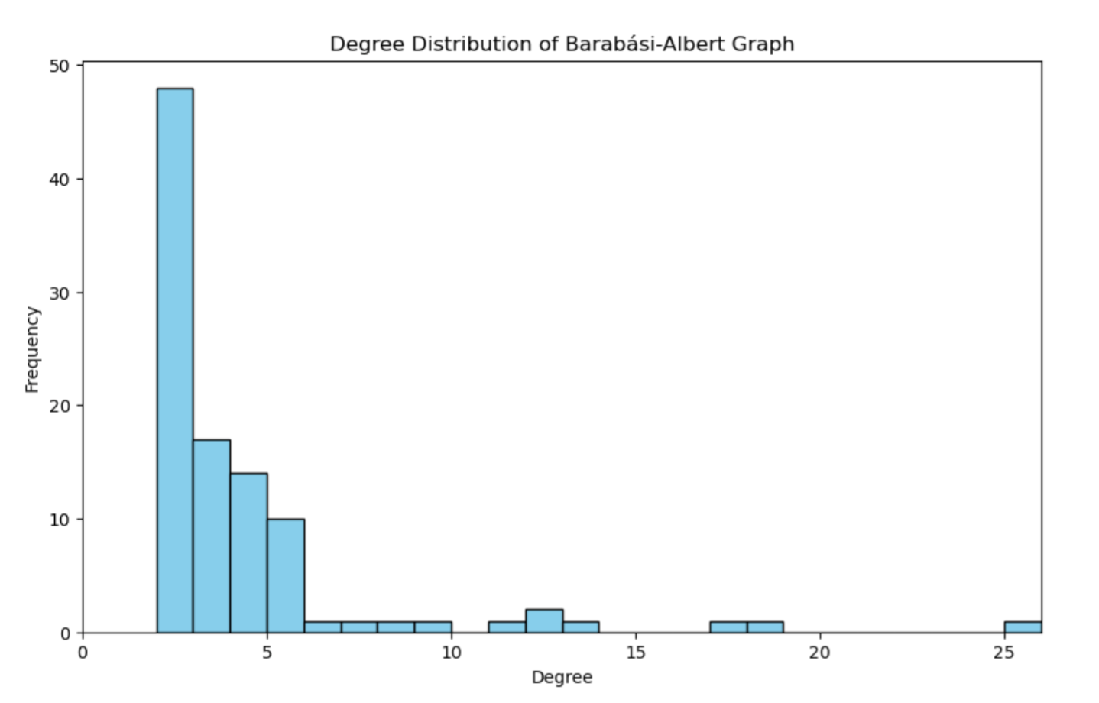
Barabási-Albert model

Slide 28

This analysis of the American College Football network has provided valuable insights into the structure and importance of teams within the network. Through various centrality measures, we identified key universities that play crucial roles in connecting different conferences, efficiently reaching other teams, and influencing the overall network. The findings highlight the interconnectedness of teams and the strategic positioning of key players in shaping the outcomes of games and the dynamics within college football. This understanding is essential for improving game scheduling, team strategy, and enhancing the competitive landscape of college football.

Slide 29
